Slide 1
Software Testing and Quality Assurance
SWE 3643
M-W 6:30 to 7:15
Face to Face, room 151
Jeff Adkisson
JAdkiss1@Kennesaw.edu
https://github.com/jeff-adkisson
Please call me Jeff or Professor.
I am not a Doctor.

Slide 2
Welcome!
I am glad you are here. Unlike some professors you may have had, I enjoy teaching and I enjoy working with students.
I like to get to know everyone’s name, so anytime we talk or you ask a question, expect me to ask your name if I don’t know (or remember) it.
I am not great with remembering names, so expect me to take a while. It’s me – not you.
Hopefully, you will learn a little bit about testing and quality assurance. This is a large, complex topic and we will only scratch the surface of it. Some people make a career out of this topic, so stretch yourself if you find the material interesting.

Slide 3
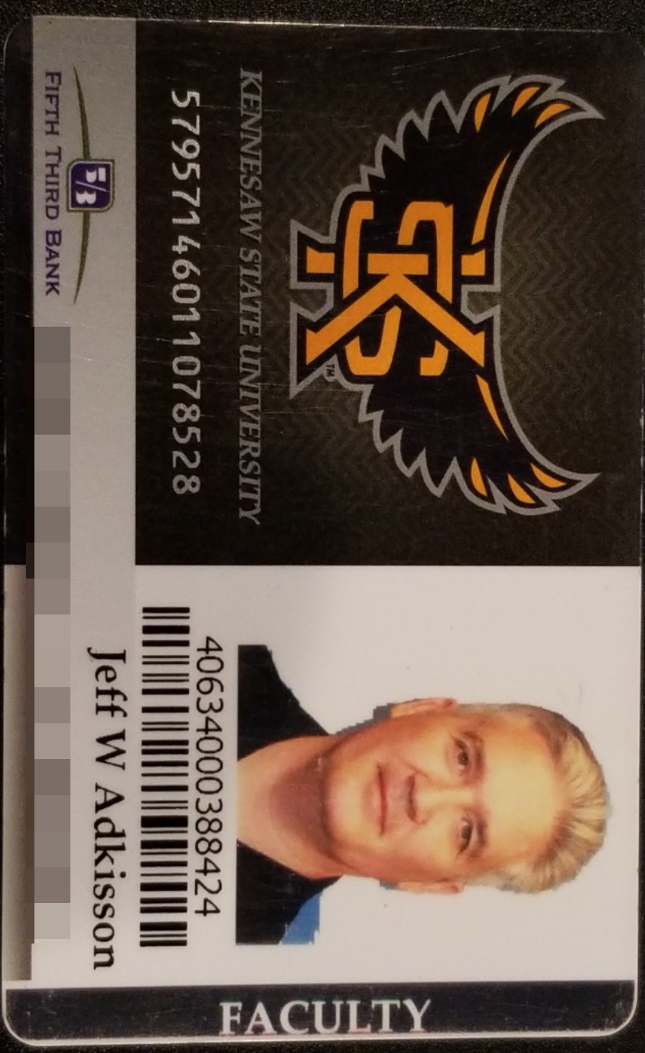
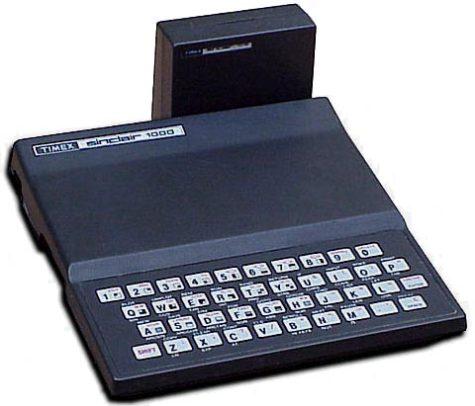
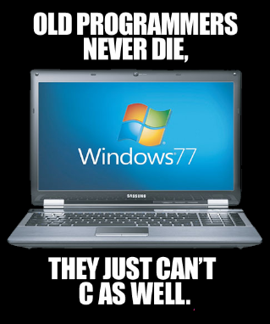
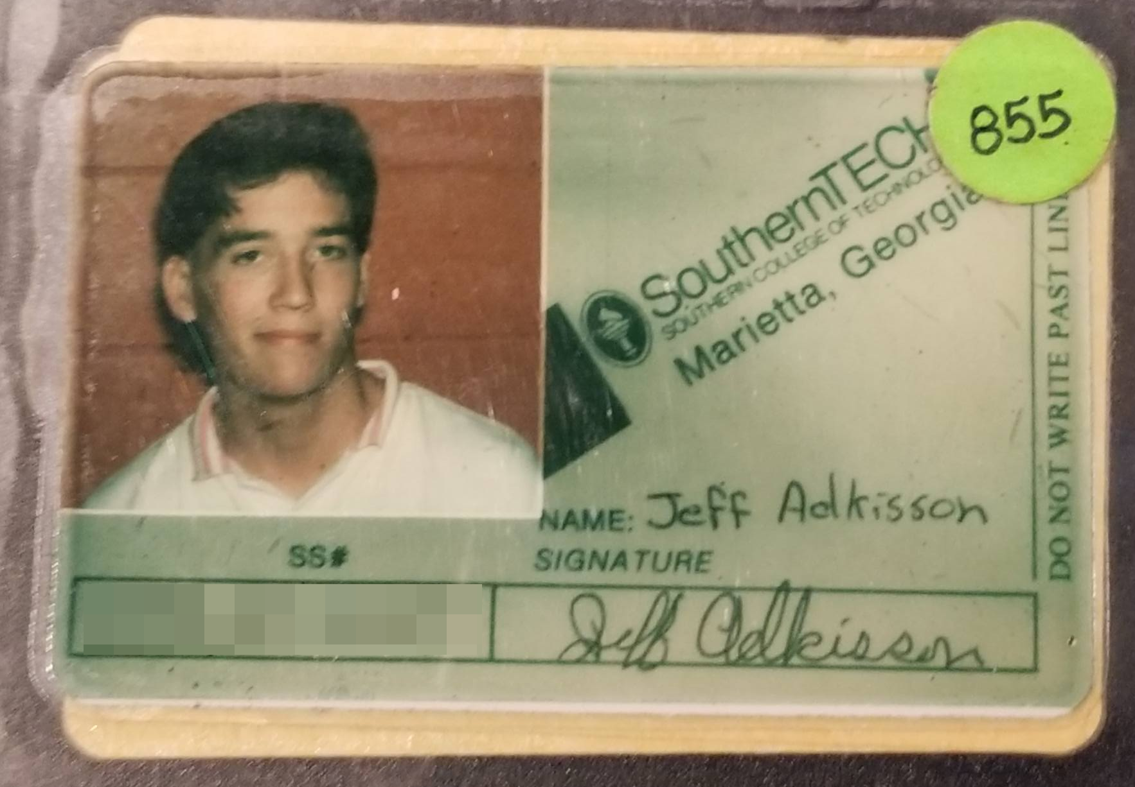
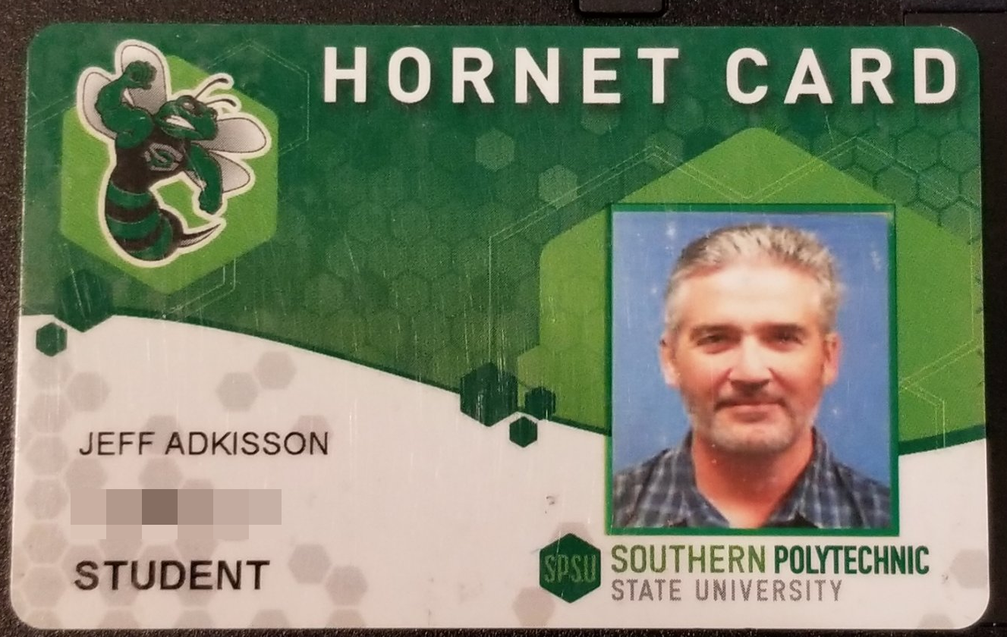
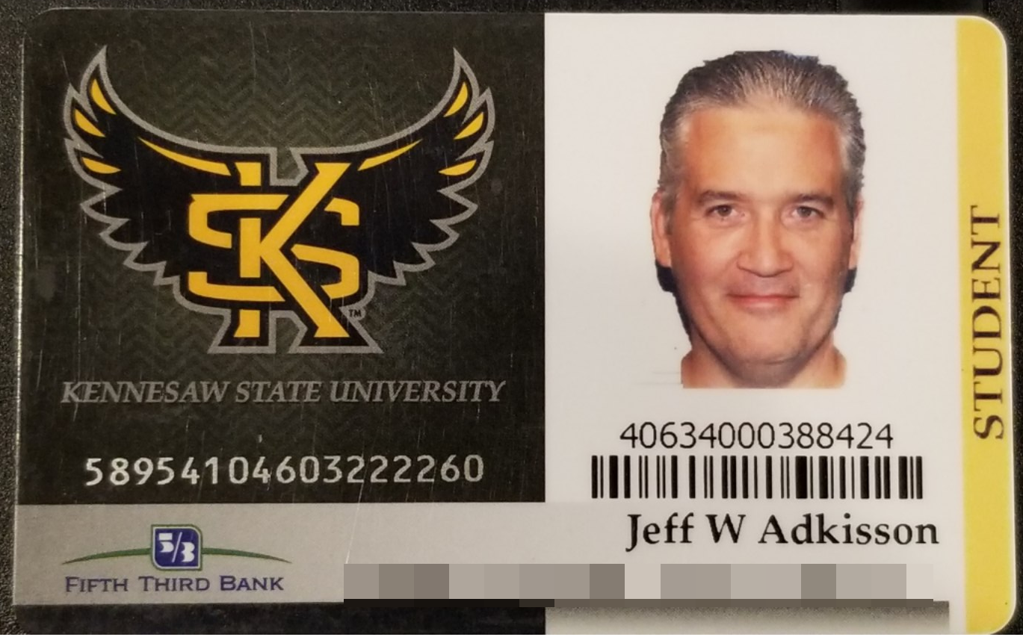
About Me
Started programming at 12 First computer Timex Sinclair 1000, 16k of RAM, Z80 processor
Started ACS program 1988 when this school was named Southern Tech
Worked in software field since 1994
Started CS Master’s in 2013 when SPSU
Graduated 2017 from KSU
Part-time KSU instructor since 2017

Slide 4
Where am I from?
I am from Georgia.
High School Pebblebrook in Mableton, graduated 1988 with a mediocre GPA and an average SAT score that got me into every college to which I applied. Times have changed.
Colleges Southern Technical Institute, now KSU from 1988 to 1990. Undergraduate from UGA in 1993 (a C student with an mediocre SAT score, LOL not these days) Masters Degree from KSU in 2017 (started under SPSU)

Slide 5
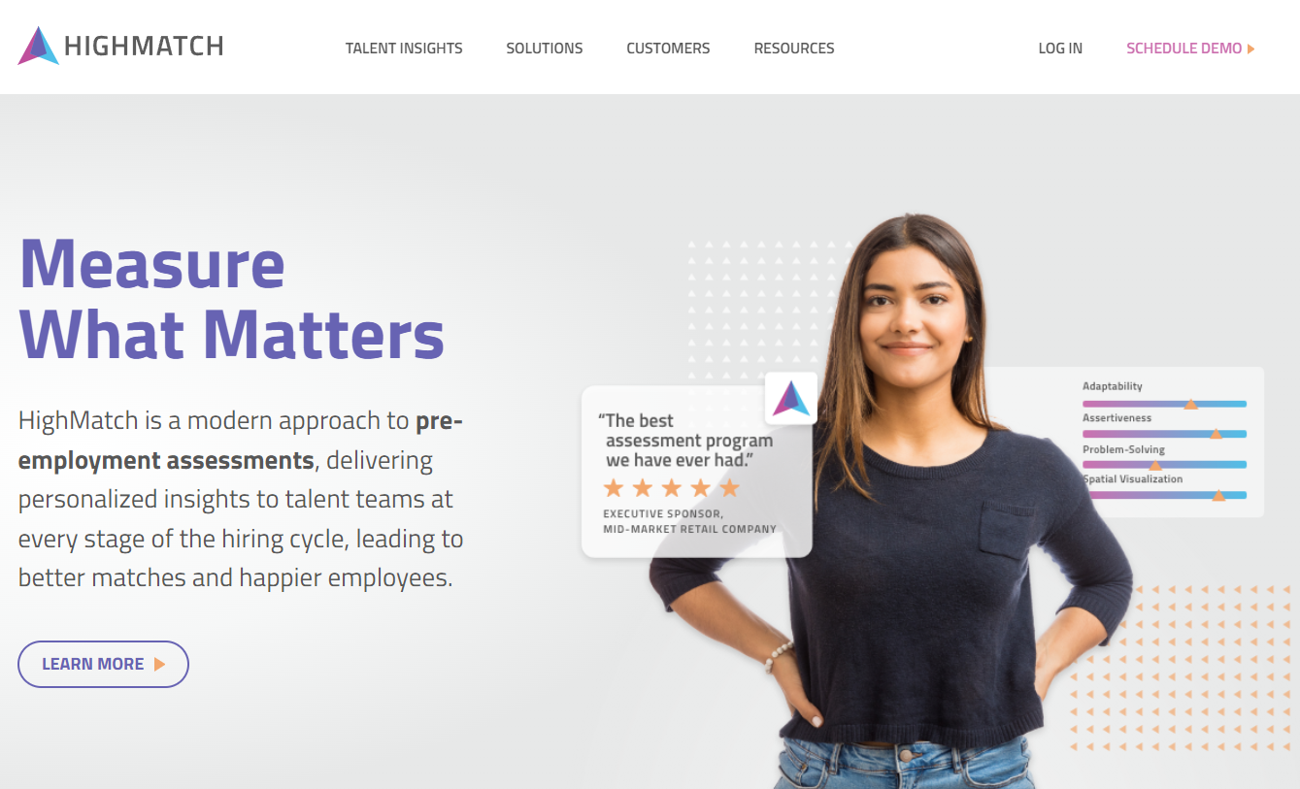
What I Do Every Day
Since 2010, I have been the Chief Technology Officer at HighMatch.
We create personality, cognitive, behavioral, and skills assessments that are delivered online.
Most of my job these days is design, documentation, recruiting, coaching, working with customers and vendors, and a little bit of management (I try to avoid hiring people who need a lot of hands-on management).
Our current tech stack is mostly:
C# I write C# almost every day. I am much better with C# than Java.
SQL I can write the craziest SQL you will ever see. That is not a recommendation for writing crazy SQL.
HTML/CSS/Javascript/Typescript/Angular/Blazor/MVC/REST I started doing web development in 1994.
Mac (development) and Linux (production) We still run a number of Windows servers and frameworks as well.

Slide 6
Why Am I Teaching This Class?
I like to teach.
Sometimes I recruit former students to work at my company, HighMatch. I look for high-performing students who like to code, are strong communicators, and work well with others. I currently have 2 full-time former students and 4 part-time former students in my team.
I plan to teach full-time someday when I retire from the industry.
I have made a lot of mistakes you can avoid. I will tell you about some of them. You will wonder how I made it this far in life.

Slide 7
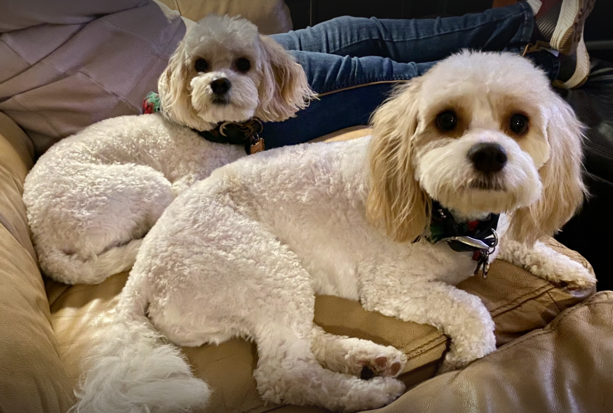
What I Like
Chloe
Smart
Barks
Digs
Territorial
Max
Not so smart
Great hair
Worships Chloe
Poops in the house
LOVES tennis balls

Slide 8
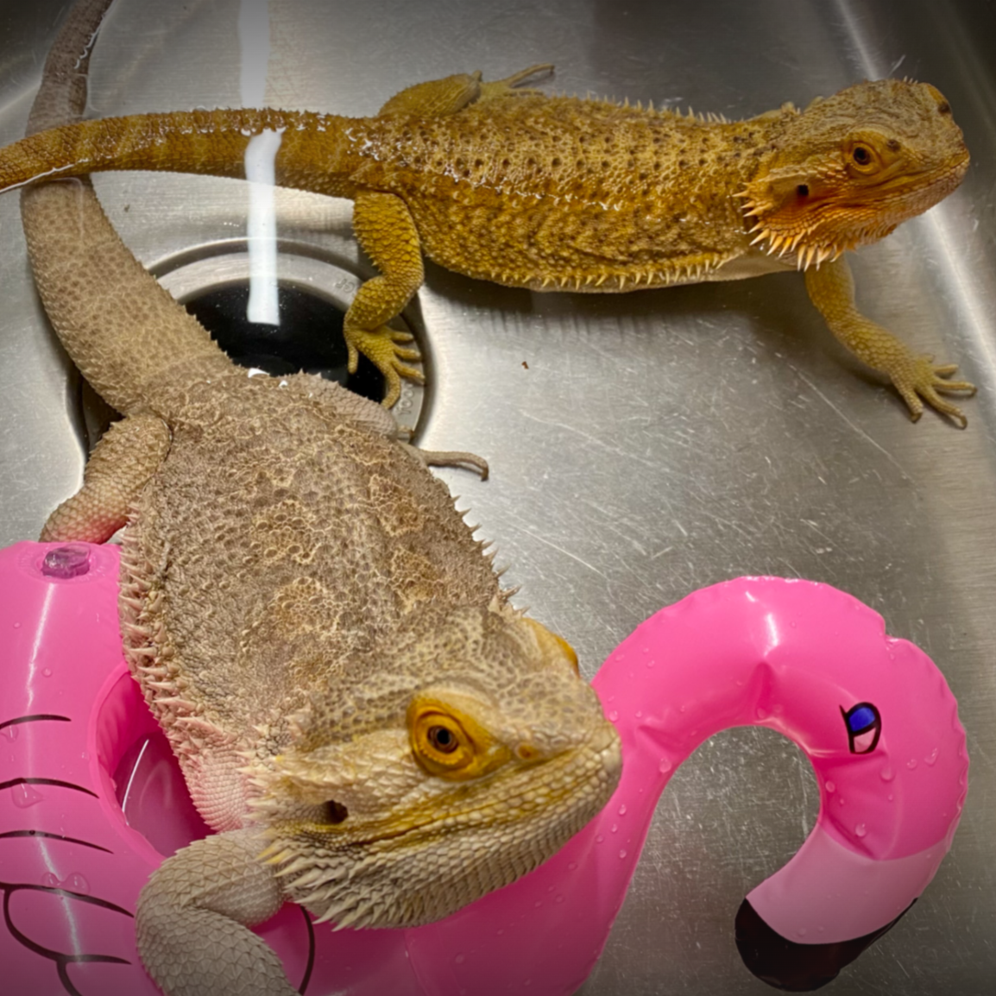
What I Like
Girlie
Belongs to Jeff’s college age daughter, Lyndsey
Every morning, pushes open her tank, jumps out, runs into the Dining Room, and curls up next to the piano
Thinks Poe should work out a little bit
Poe
Lazy… so lazy he must be hand-fed
Giant (for his breed)
Wants to be Girlie’s boyfriend

Slide 9

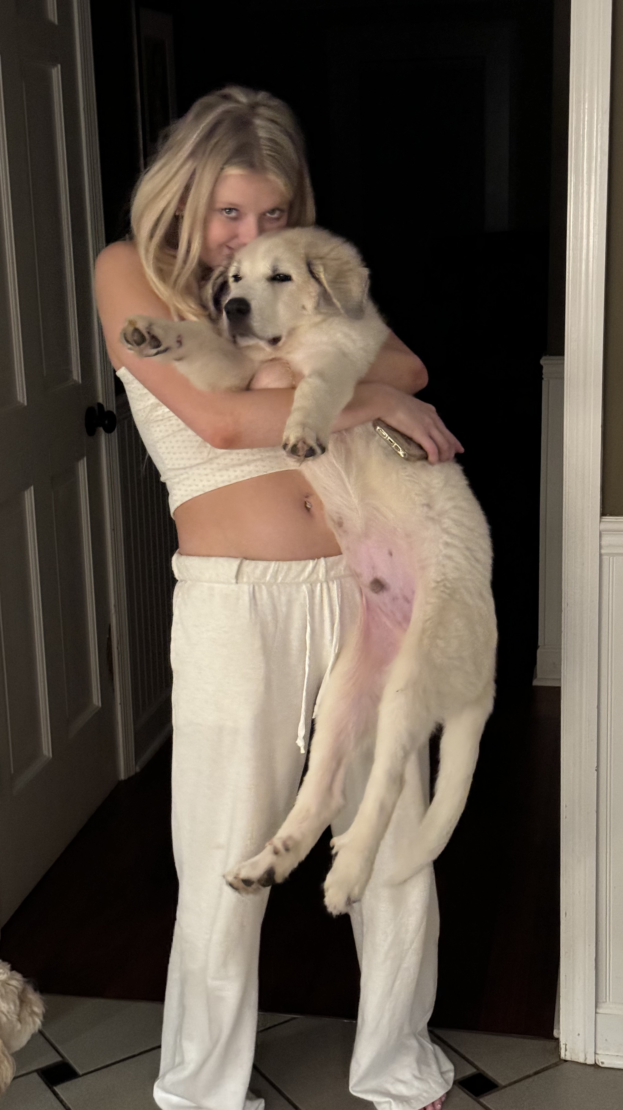
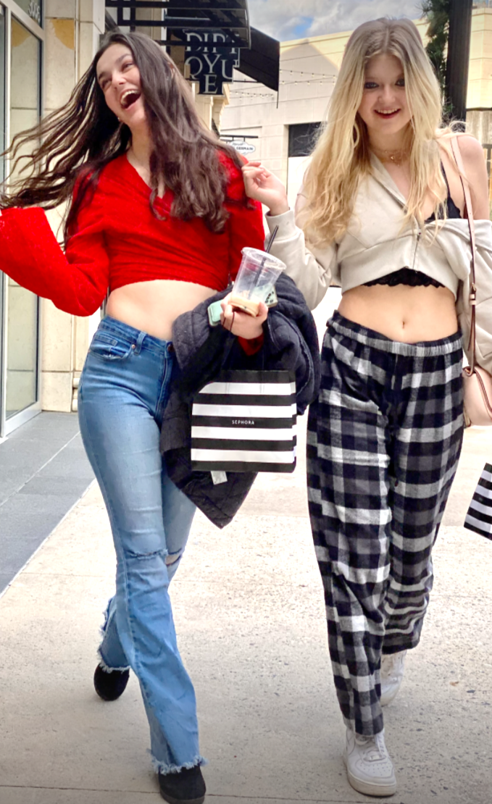
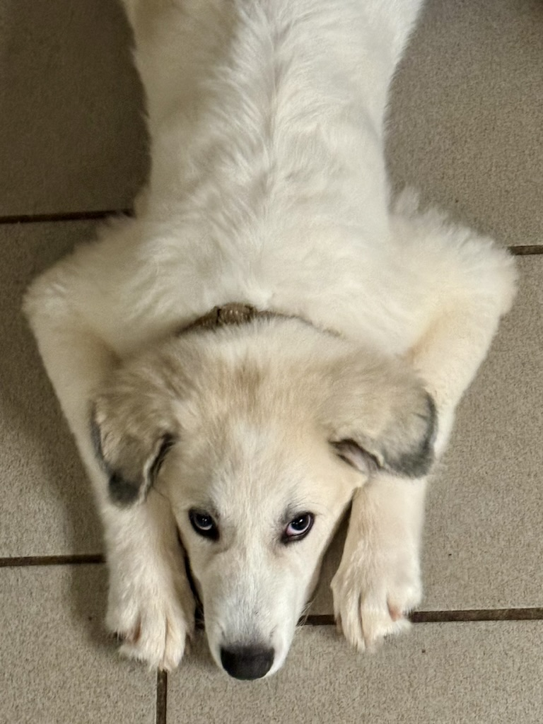
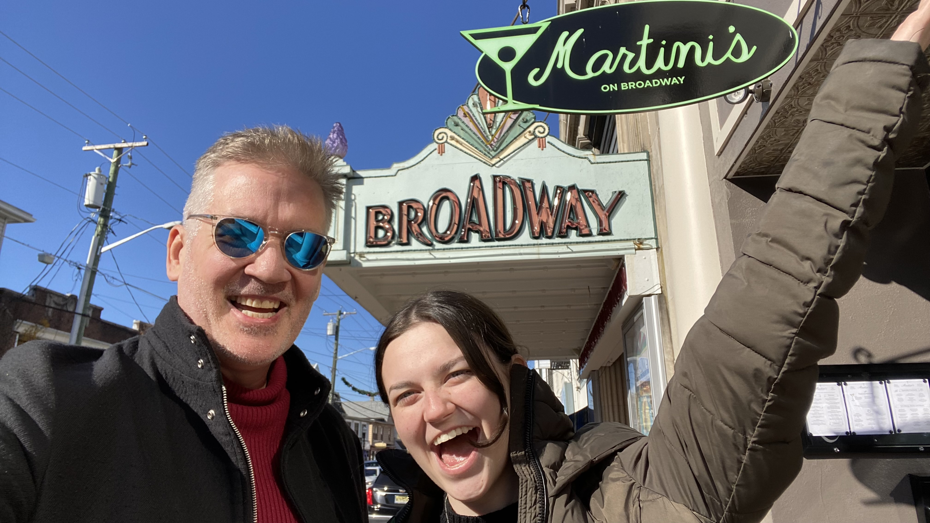
What I like
Lyndsey
Senior at Rider University, NJ
Musician and performer
Sydney
Senior in High school
Future salon owner
Has a giant Great Pyrenes named Mango

Slide 10
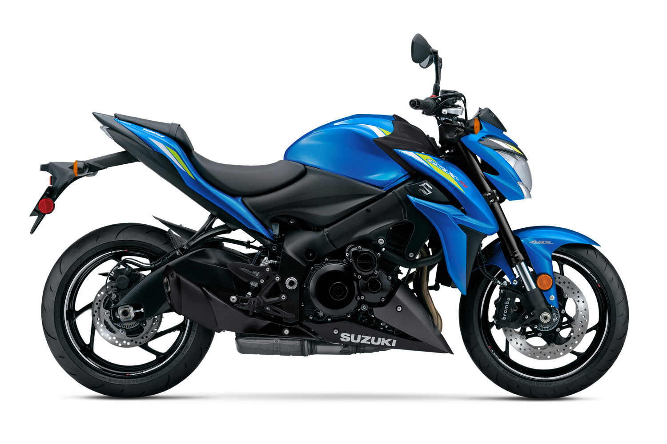
What I Like
Suzuki GSX-S 1000F

Slide 11
What to Expect in the Course
A mix of academic lectures and observations from 30 years of industry experience.
An emphasis on coding. A large coding project in this course is half of the course grade. You cannot master these concepts without writing code… learning concepts without applying them in code is like going to the gym and watching other people work out.
An emphasis on professional-grade documentation. The longer you are in this field, the more time you will spend writing. The best engineers are outstanding communicators.
An emphasis on source control. That means git and Github right now. This is an essential skill for software engineers, and few, if any, of your other KSU courses require you to learn it.

Slide 12
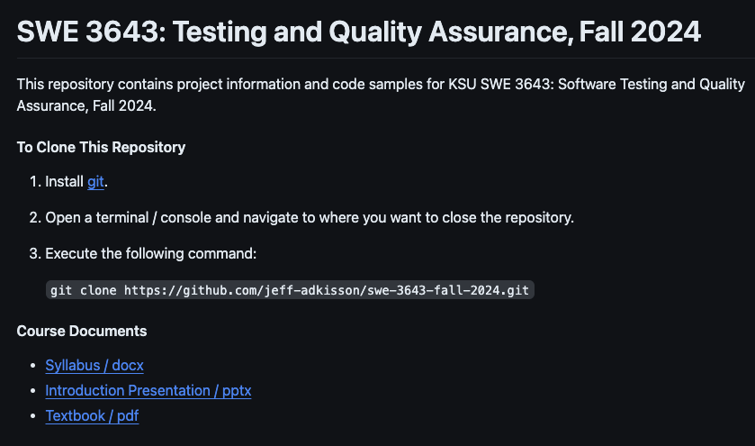
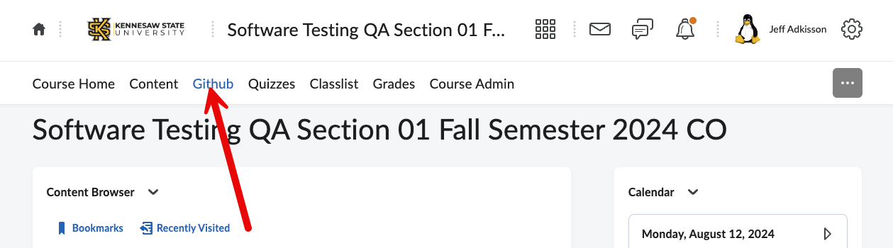
Speaking of source control and git…
https://github.com/jeff-adkisson/swe-3643-fall-2024

Slide 13
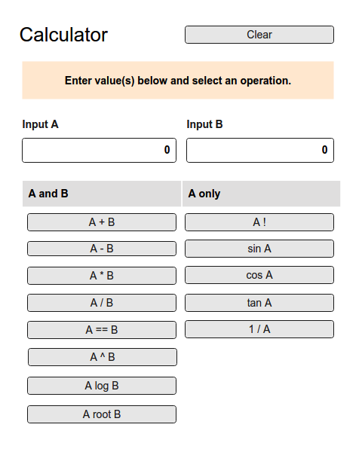
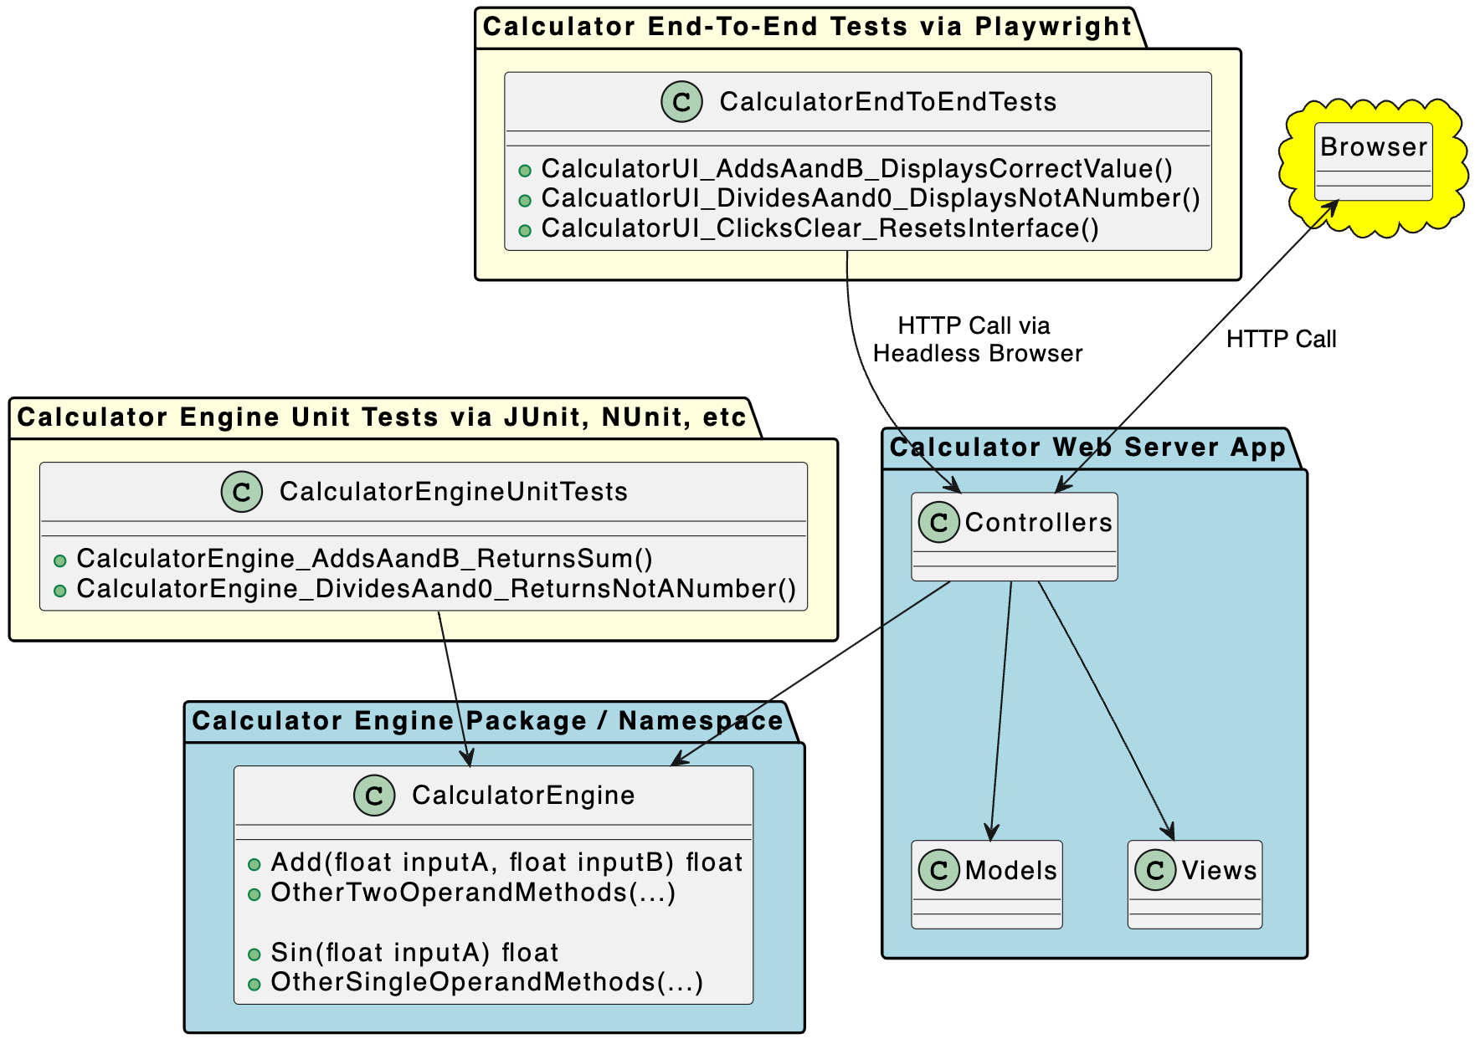
Speaking of Coding…
This course has a large semester project. It is 50% of your grade.
You can work alone (recommended) or in pairs. Your choice.
I will provide more information in a few weeks.
You will create a web-based application that has various types of unit and end-to-end tests to validate behavior.
You will use Java, C#, or Python.
You will code with a JetBrains IDE – Intellij, Rider, or Pycharm.
You will use Junit, Nunit, or Pytest for unit tests.
You will use Playwright for end-to-end tests.
You will be amazed what you can accomplish.

Slide 14
Coding makes me anxious…
Some students get anxious coding a large project. Some of you may not have written anything substantial yet.
That’s OK. I will get you through this. I do this every semester and 95% of my students do great.
Which leads you to “who does not do great?”
That’s easy… the students who do not put in the effort, skip lectures, and wait until the last minute.
Anyone can code, but like anything worthwhile, it takes some effort to learn how to do it.

Slide 15
What to Expect in my Classroom
I do not care if you pay attention, but do not disturb or distract your classmates. If you want to text, play games, or watch videos, please do it elsewhere. Even if you are quiet, the person behind you might find your screen a distraction.
If you arrive late, leave early, or need to step out, that’s fine. Just do not disturb your classmates or me.
I do not take attendance. If you cannot attend, you do not need to tell me. It is your responsibility to understand the material I cover when you are not present. Please do not email me asking for a review of what happened.
Ask questions.
Correct me if I make a mistake. I am not perfect and I do not know everything.
If I go past the end of the lecture time, stop me! Sometimes I talk too much.
Everyone here is an adult. I will treat you like a responsible adult, so keep up with your readings, practice assignments, quizzes, and project. Everything you need will be in D2L, our twice-weekly lectures, your text, or my Github repo.

Slide 16
I Want You to Graduate With…
The confidence you can learn new things quickly. No one knows everything. The best engineers can learn and adapt to new projects rapidly.
Outstanding problem-solving and research skills. This is the most important skill you must develop to be a successful engineer.
-The discipline to grind through tough problems and manage your anxiety. Sometimes you have to sit at a desk all night just grinding on a problem. This still happens to me, even with many years of experience. This can be a very solitary, isolating, mentally taxing field.
The understanding that you will never master this discipline, but you must always pursue mastery by learning new skills, mastering (and re-mastering) old skills, and avoiding getting too complacent/comfortable with your current abilities. This gets exhausting.
The humility that you do not know everything, and will never know everything. This work will humble you over and over. Learn that there are very few ”never do this” or ”always do this” situations in real life.
The ability to make a mistake, take accountability for the mistake, and learn from your mistakes. The last bit is the most important. As best you can, avoid making the same mistake twice. And as much as you can, learn from other peoples’ mistakes. Often, there are many paths to success, but never forget that there are infinite paths to failure.

Slide 17
This Wednesday
Our first lecture is on Wednesday.
Next week:
you will have your first D2L quiz due (syllabus quiz, super easy, 2% of your total grade), and
I will release the first practice assignment (which, as noted in the syllabus, is not graded).
Follow the course schedule for readings.

Slide 18
Software Testing and Quality Assurance
SWE 3643
M-W 6:30 to 7:15
Face to Face, room 151
Jeff Adkisson
JAdkiss1@Kennesaw.edu
https://github.com/jeff-adkisson

